Slide 1
Power BI
Introduction to Power BI and Key Features
Exploring Power BI Desktop Interface
Data Transformation and Modeling
Data Analysis Expressions (DAX)
Advanced DAX Calculations
Charts, Page Layouts, and Dashboard Creation
Publishing, Sharing, and Hands-On Exercises

Slide 2
Introduction to Power BI
Power BI is a powerful business intelligence and data visualization tool developed by Microsoft.
Data Connectivity: Connect to various data sources.
Data Transformation: Clean, reshape, and combine data using Power Query.
Data Modeling: Create relationships, calculated columns, and measures.
Report Authoring: Build interactive reports and dashboards in Power BI Desktop.
DAX: Use Data Analysis Expressions for custom calculations.
Data Insights: Quick Insights feature for automatic pattern discovery.
Sharing: Publish, share, and collaborate on reports in Power BI Service.
Mobile Access: Access and interact with reports on mobile devices.
Custom Visualizations: Extend and customize visuals.
Security and Governance: Ensure data privacy and compliance.

Slide 3
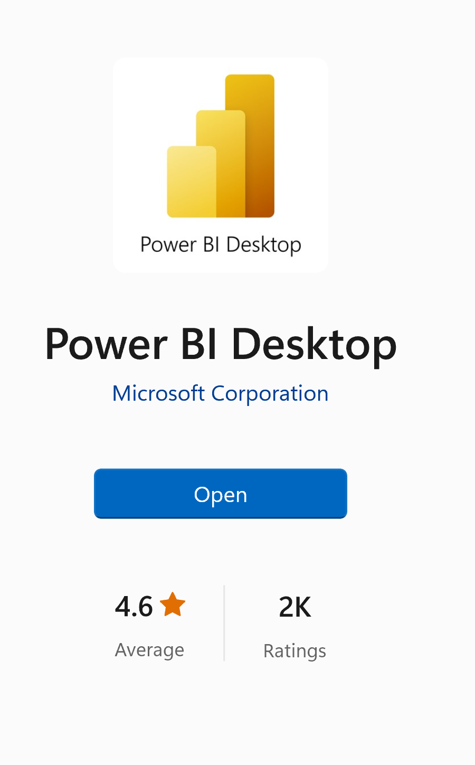
Cont…
Installation and Setup:
Download Power BI Desktop from the Microsoft website.
Install Power BI Desktop on your Windows computer.
Create a Power BI Service Account for sharing and collaboration.
Connect to Data from your data sources.
Build Your Reports using Power BI Desktop.
Publish to Power BI Service for sharing and setting data refresh schedules.

Slide 4
Cont…
Power BI and Power BI Desktop
Feature | Power BI | Power BI Desktop
Role | Entire ecosystem for BI | Standalone report authoring
Platform | Cloud-based, web, and mobile | Windows application
Collaboration | Share, collaborate, and publish | Report creation and design
Access | Accessible via web and mobile | Can be used offline
Cost | Typically, subscription-based | Free to download and use

Slide 5
Power BI Desktop Interface
Overview of Power BI Desktop Interface:
  Ribbon: Top menu for actions and tasks.
  Visualizations Pane: Right-side panel for configuring visuals.
  Fields Pane: Right-side panel displaying data fields.
  Report View: Central canvas for building visuals.
  Pages Pane: Left-side panel for managing report pages.
  Filters Pane: Right-side panel for adding filters.
  Data View: View the underlying data tables.
  Model View: Visualize table relationships.

Slide 6
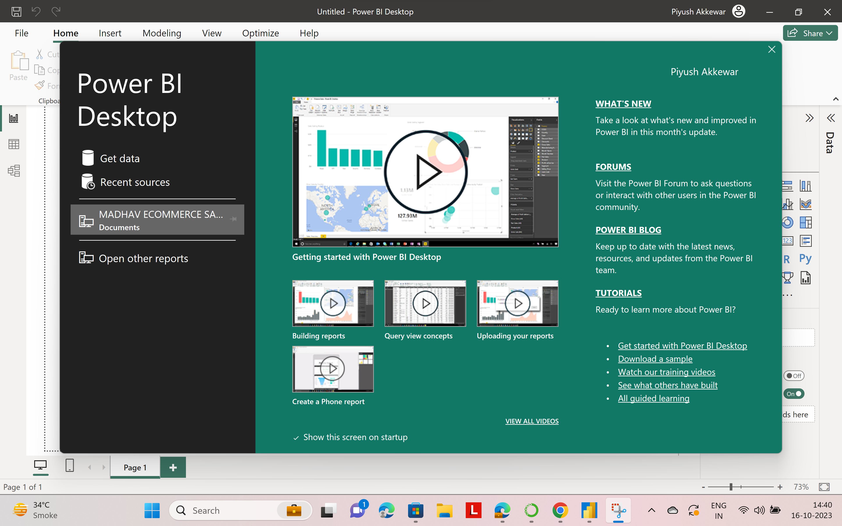
Cont…

Slide 7
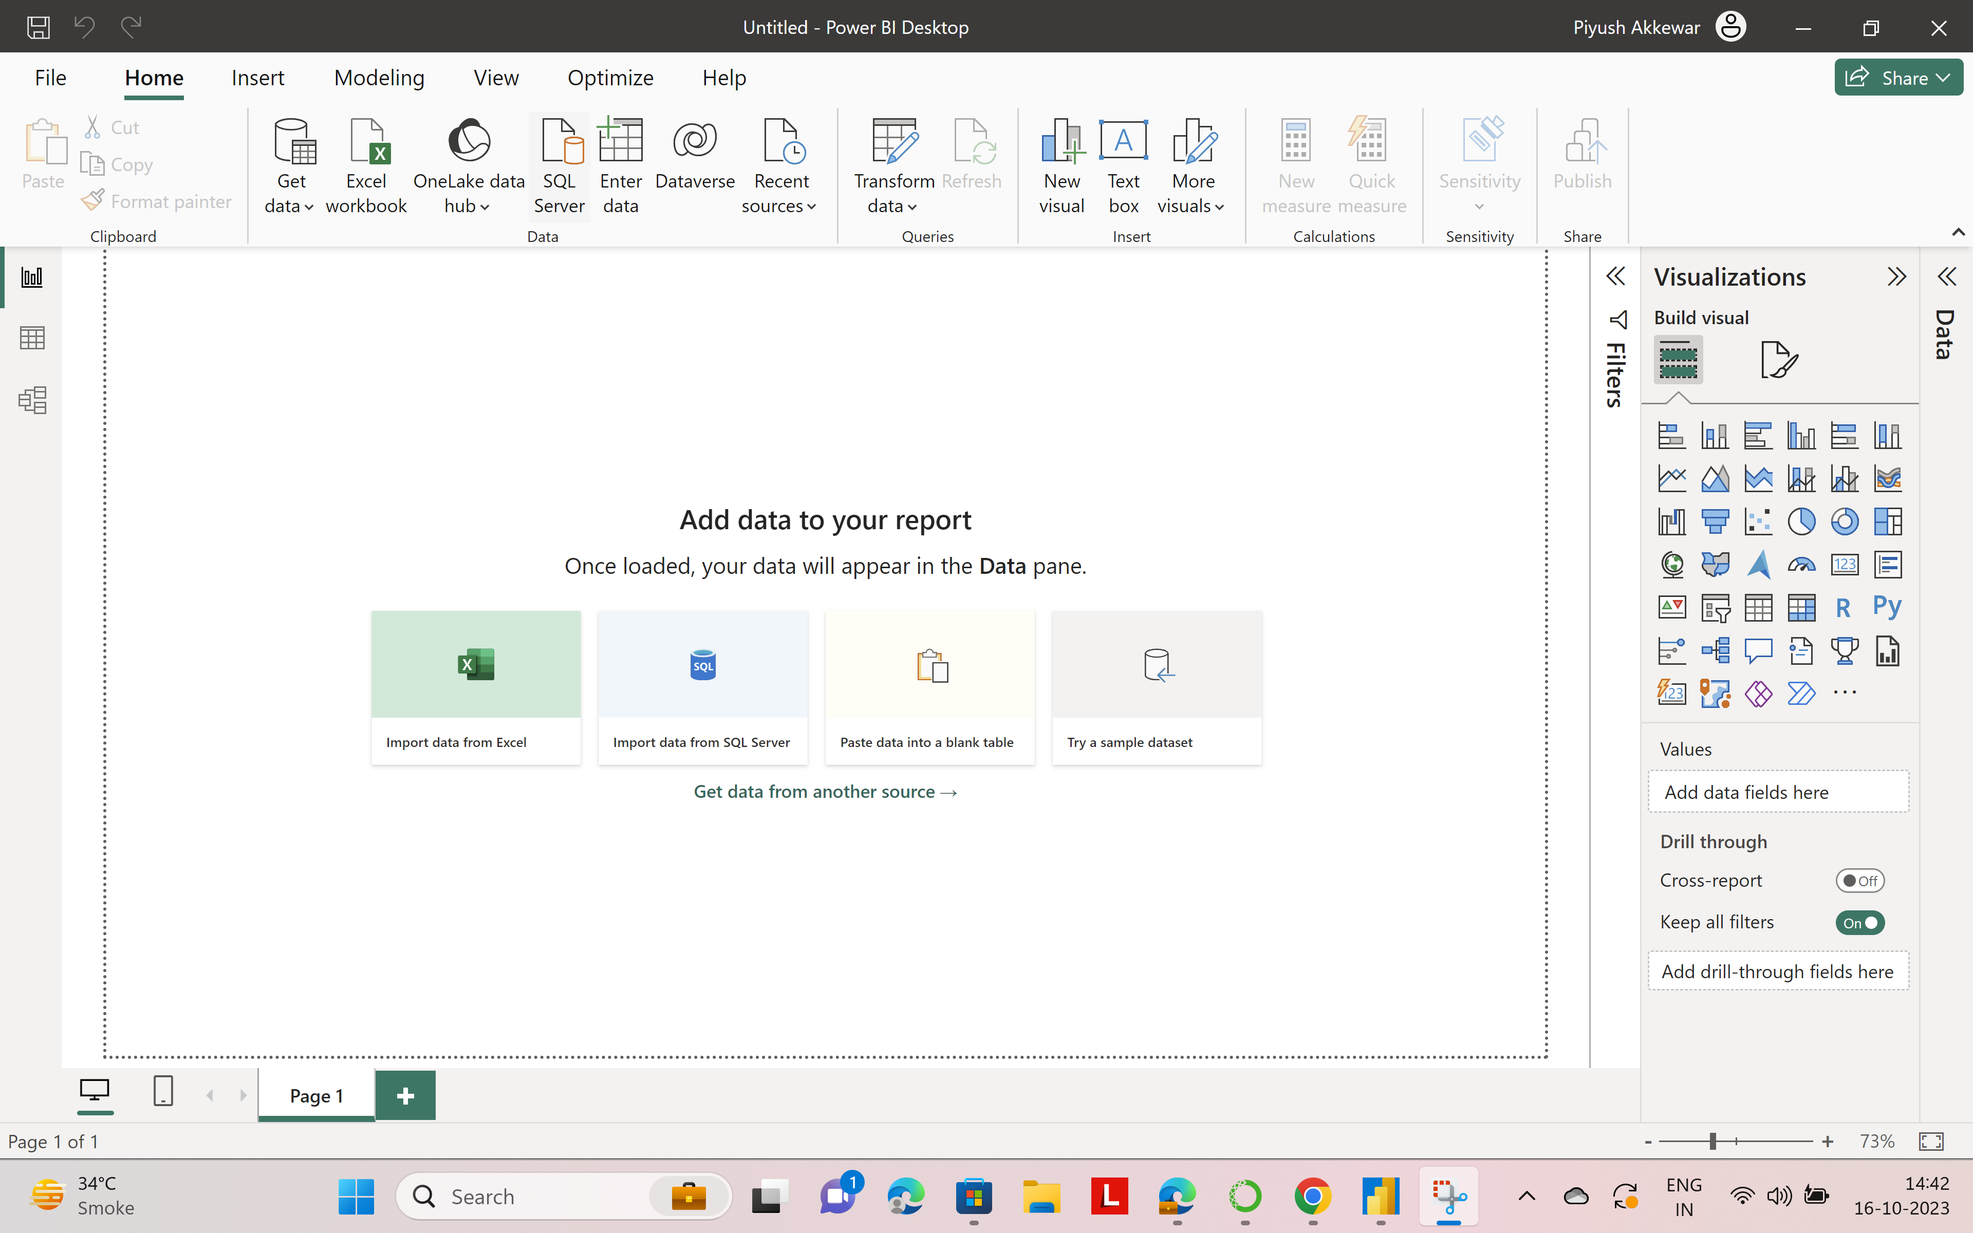
Cont…

Slide 8
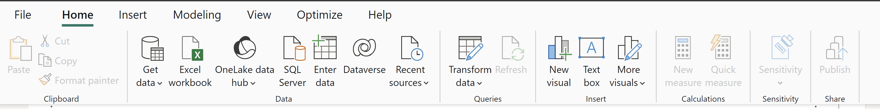
Power BI Workspace Elements
Ribbons:
  Home, Model, View, Transform Data, External Data: Manage data, visuals, and design settings.

Slide 9
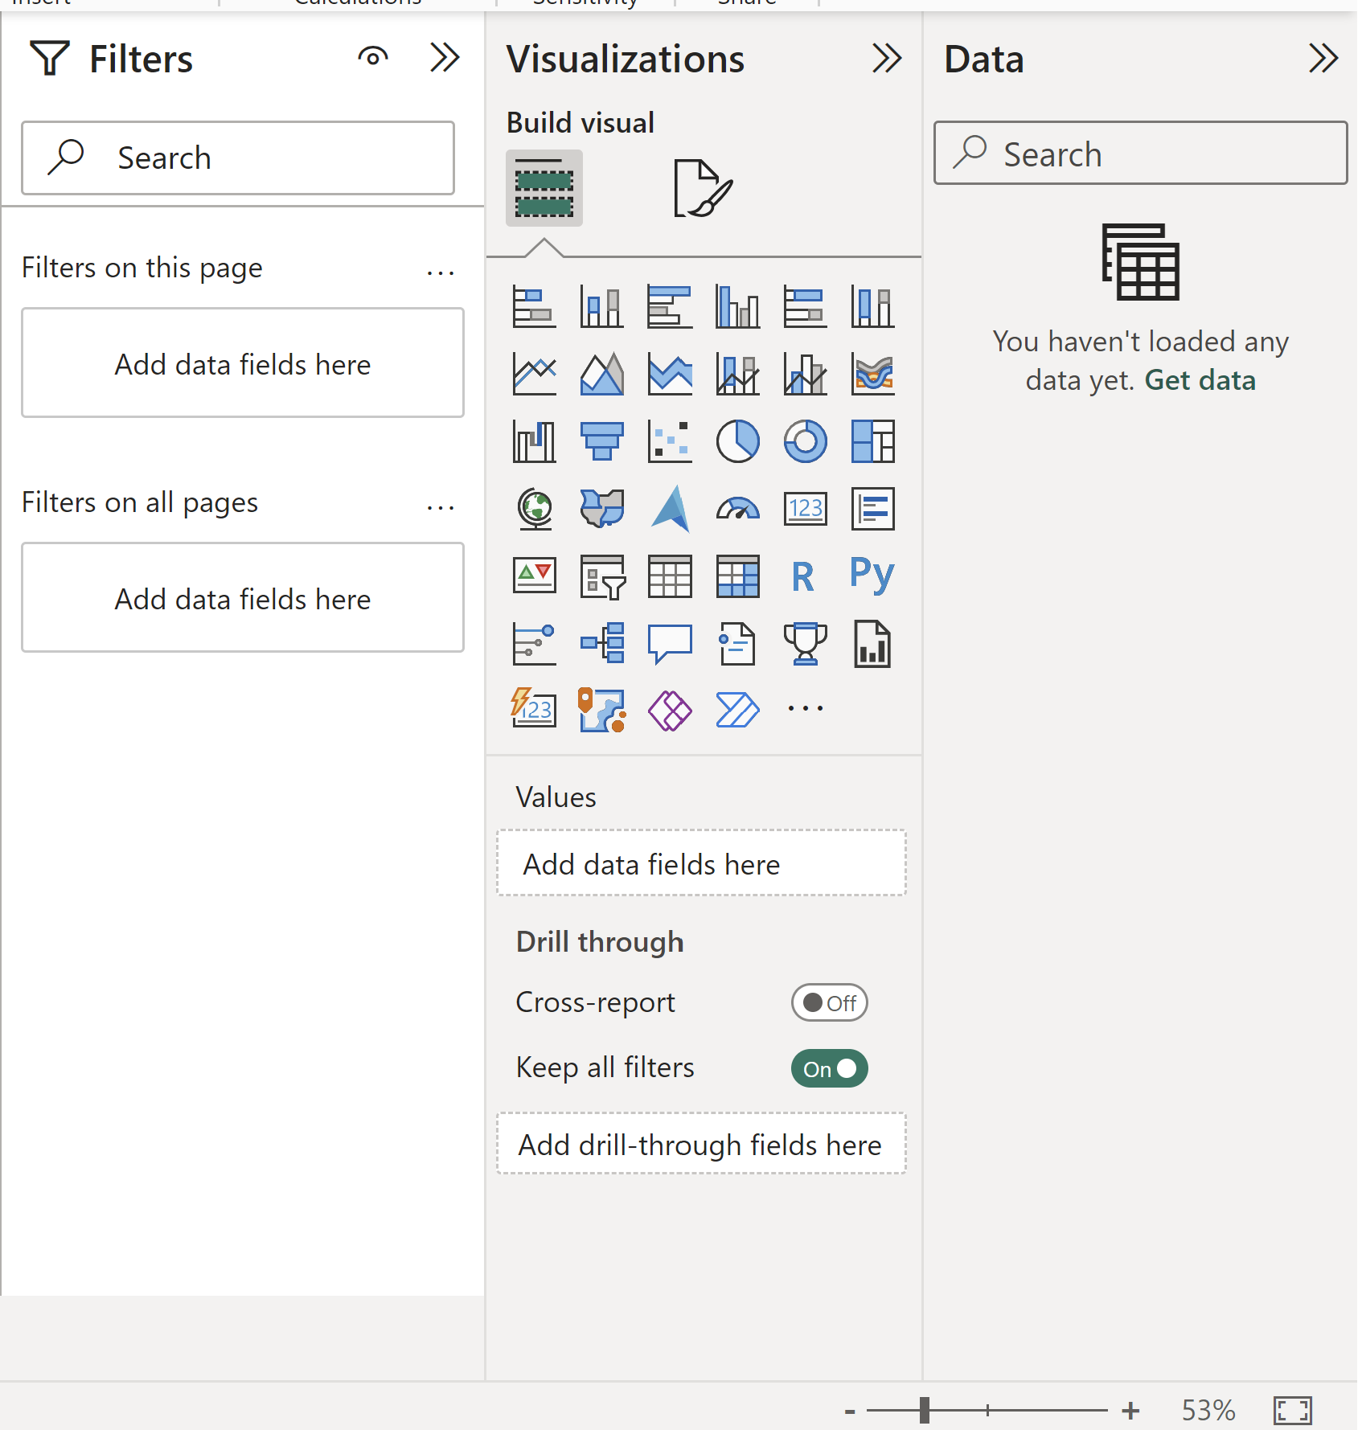
Cont…
Panes:
  Fields Pane: Connect to data sources and select fields.
  Visualizations Pane: Choose visual types and customize them.
  Filters, Selection Pane: Add interactivity and manage visual layers.

Slide 10
Cont…
Menus:
  File, Edit, View, Data, Model, Visualizations: Access file operations, editing, view settings, data management, and report customization.

Slide 11
Data Transformation
Import Data: Load your data into Power BI from various sources.
Query Editor: Access it from the Home tab for data transformation.
  Filter Data: Remove unnecessary rows/columns.
  Transform Data: Change data types, split/merge columns, create custom columns.
  Clean Data: Handle missing values and data anomalies.
Data Modeling: Create relationships between tables if needed.
DAX Calculations: Use Data Analysis Expressions to create custom calculations and measures.
Loading Data: Apply data transformations and load data for visualization.
Data Refresh: Set up automatic data refresh for dynamic data sources.

Slide 12
Data Modeling
Data Modeling Concepts:
    Tables: Identify data tables.
    Columns: Understand attributes.
    Relationships: Define connections.
Establishing Relationships:
    Identify Keys: Use unique identifiers.
    Create Relationships: Connect related data.
Hierarchies:
    Date Hierarchies: Year > Quarter > Month > Day.
    Custom Hierarchies: Define custom data structures.

Slide 13
Questions ?

